Slide 1

User Manual
Apache Atlas

Slide 2
Explanation of Apache Atlas System
The main steps of uploading metadata and managing it in the system

Slide 3
Instructions
01
Main camps - properties
09
Schema
02
Properties
10
Business Data Administration
Each slide represents explanation of existing and created fields in Atlas
03
User-defined Properties
04
Business Metadata
05
Lineage
06
Relationship
07
Classification
08
Audit

Slide 4
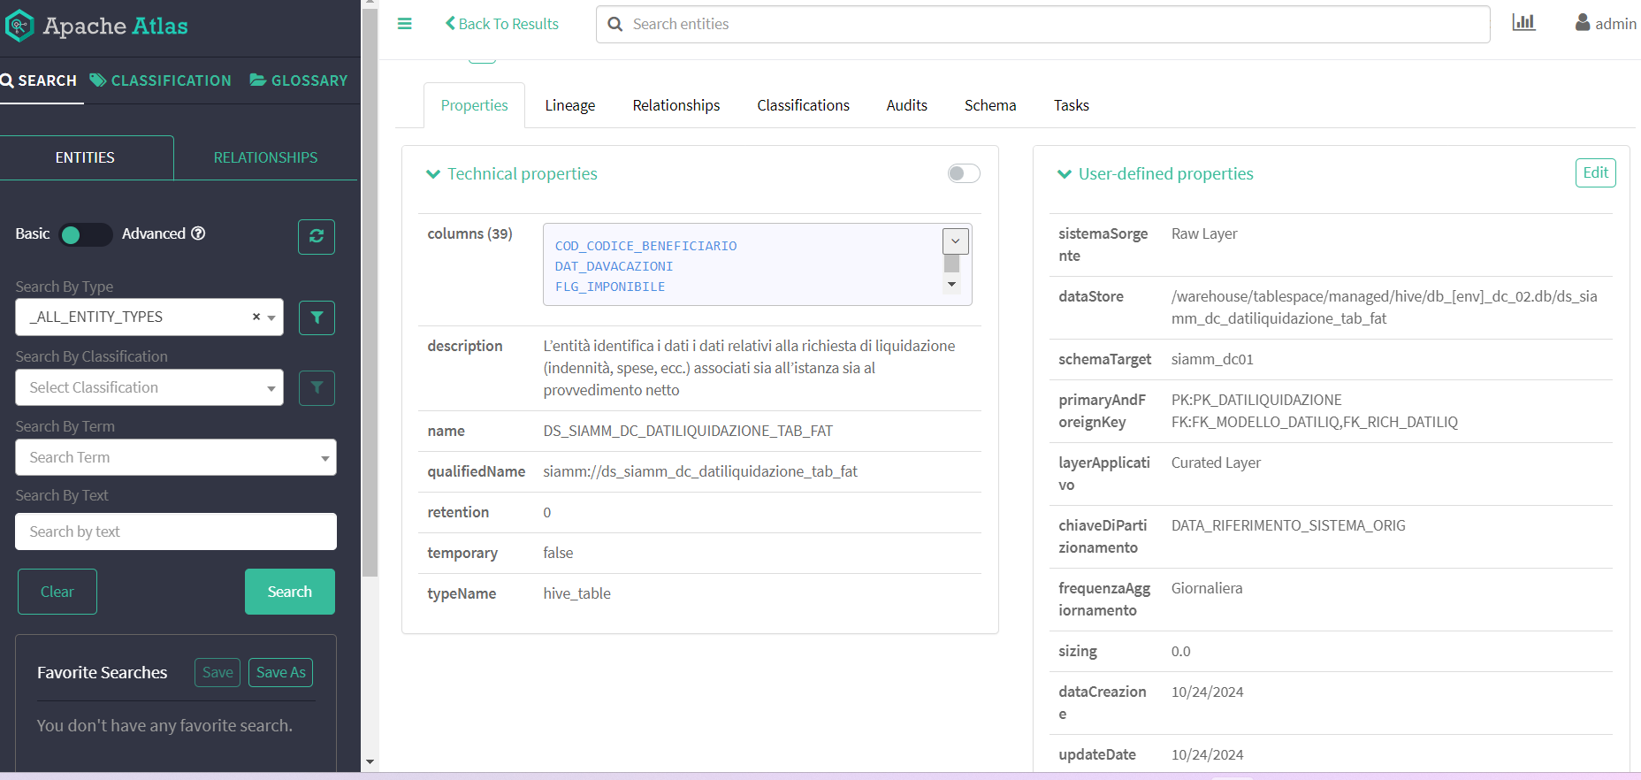
Main camps of tables/columns
Properties contain information
about metadata,
both technical and business
User-defined
properties -
Thecnical
metadata
created
by user
Explanation of fields in user interface - properties
Search field
used to
specify filters
and find certain
entitities
Technical
properties -
technical
metadata
inserted
in the system
Serach by
classification
type

Slide 5
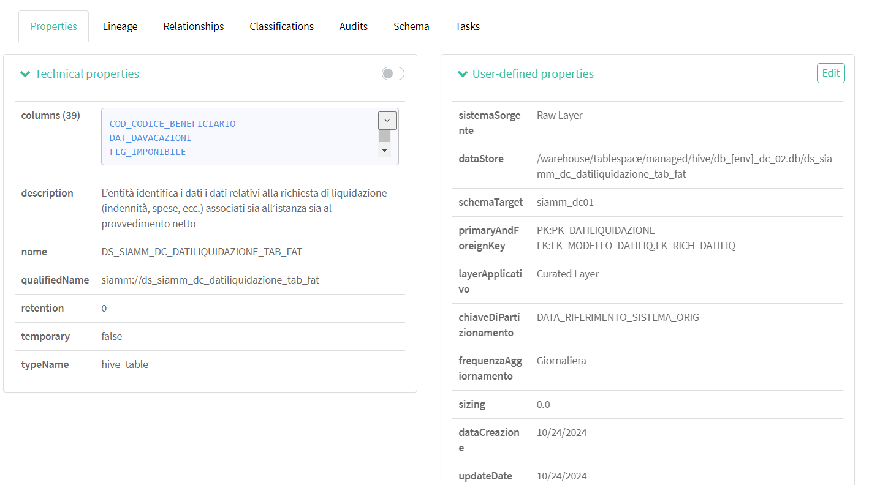
Properties
Explanation of fields in user interface
Technical properties
is a field with thechnical
metadata already existing
in the system. It has the next rows:
columns: the list of columns inside table
description: the short description of the table
name: textual name of the dataset
qualidiedName: the unique id f table/dataset
typeName: the atlas type of the table
In the column field its possible to access
to existing columns in the table by click.

Slide 6
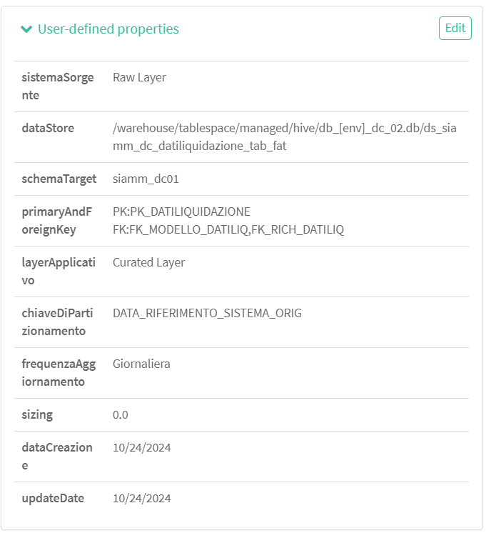
User-defined properties
User-defined properties
is a field with thechnical metadata specified by the user and
inserted into the system. It has the next rows:
sistemaSorgente: Name of the source system from which
the dataset originates, coming from the previous level
dataStore: Reference data store containing the dataset
schemaTarget: Schema of the reference data store that
contains the dataset
primaryAndForeignKey: Primary and secondary keys of the dataset;
It allows to be evaluated with N/A in case you do not want to make
the list of values explicit
…
Explanation of fields in user interface - properties

Slide 7
User-defined properties
User-defined properties
layerApplicativo: Enter the application layer in
which the dataset in question is located
chiaveDiPartizionamento: Indicate the field(s) on which
the dataset partition is applied
frequenzaAggionamento: Update frequency of the
information that populates the dataset
sizing: Indicates the sizing of the dataset
dataCreation: Entity creation date
updateDate: Date of last modification on the entity
Explanation of fields in user interface - properties

Slide 8
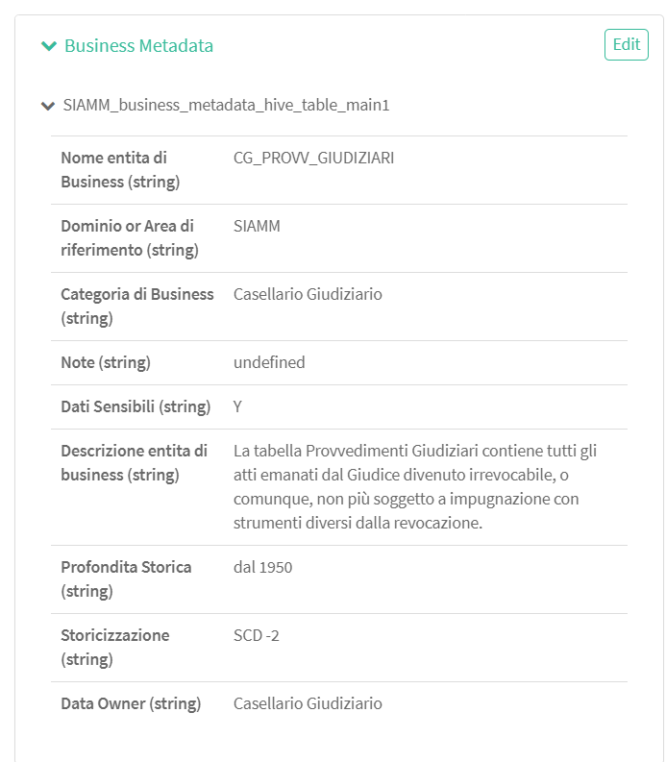
Business Metadata
Explanation of fields in user interface - properties
Business Metadata
is a field with business metadata specified by the user and
inserted into the system. It has the next rows:
Nome entita di Business: Name of the business entity that will be
associated with the dataset as a vocabulary term
Domino/Area di referimento: Description of the area to which the
information present in the dataset belongs
Categoria di Business: Category of the business entity that will be
associated with the dataset
Note: Information that enables backward and forward
analyzes (input, output, job)
…

Slide 9
Business Metadata
Explanation of fields in user interface - properties
Business Metadata
Dati Sensibili: Information used to highlight the presence of sensitive
data or data to be pseudonymized in the dataset:
- information identifying the QID data
(name, surname, municipality of birth, state of birth, date of birth)
- data falling into particular categories, i.e.
those that reveal email, telephone number, tax code, notes and descriptions
Descrizione entita di business: Description of the associated business entity
Profondita Storica: Indicates the historical depth contained in the dataset
Storicazione: Management of historical data versioning
Data Owner: person responsable for data governance

Slide 10
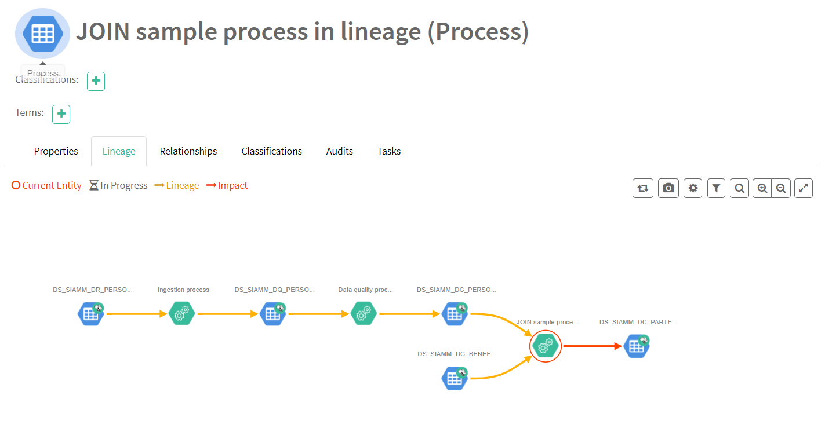
Lineage
Explanation of fields in user interface - lineage
Lineage -
Is and intuitive UI to view lineage
of data as it moves through
various processes
Here you can see how each
table/column affects
on each other and evolvong
of data for example the data
from DS_SIAMM_PERSONAFISICA
and
DS_SIAMM_DC_BENEFECIARIO
will be found in common table
DS_SIAMM_DC_PARTE_
PROCEDIMENTO
after join process of
previews two tables.

Slide 11
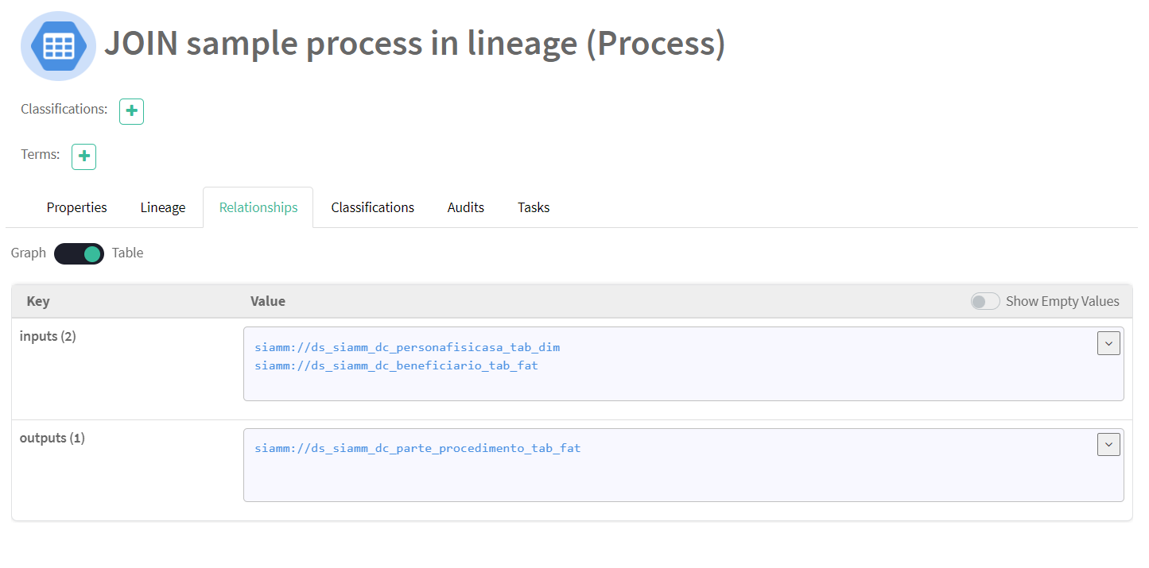
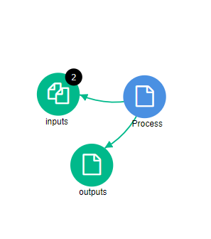
Relationship
Relationship field –
shows the relationship between
table and columns or if it is a
proccess as in te given example,
decribes how datasets relate
to each other during alterations
in the system.
Explanation of fields in user interface - relationship
If you chose graph view
You can see graphical
representation of the
Relationship between tables
or columns.

Slide 12
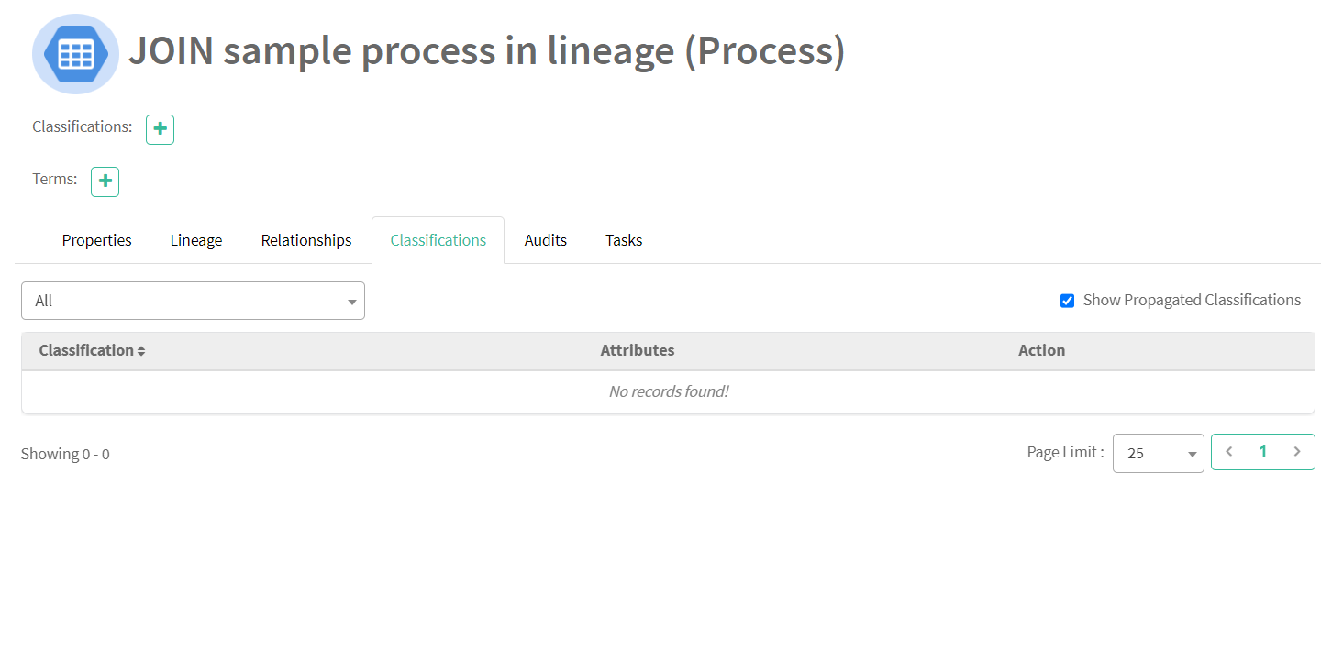
Classification
Explanation of fields in user interface - classification
Classification – helps describe
the tables/columns content,
status,
or other business-driven value.

Slide 13
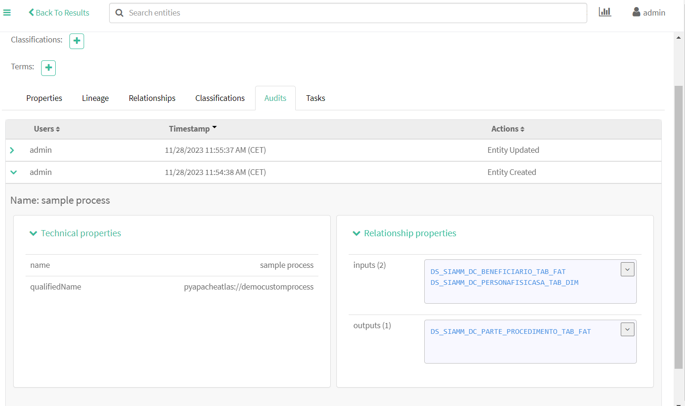
Audit
Audit – show the last updates
and alterations which
were uplied to the
tabe/column/process.
By clicking on one of the fields
You can see the changes.
Explanation of fields in user interface - audit
Timestamp –
Time when alterations was done
Actions show the type of
alterations that was done to the
Table/column/properties.

Slide 14
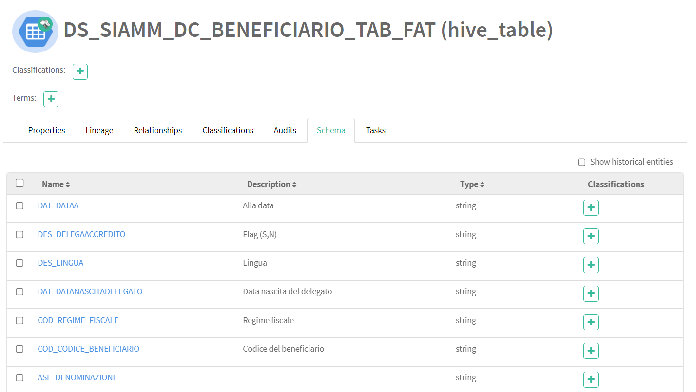
Schema
Explanation of fields in user interface - audit
Schema
The field inside the table that
Contains all table columns with its
Description, type and classification

Slide 15
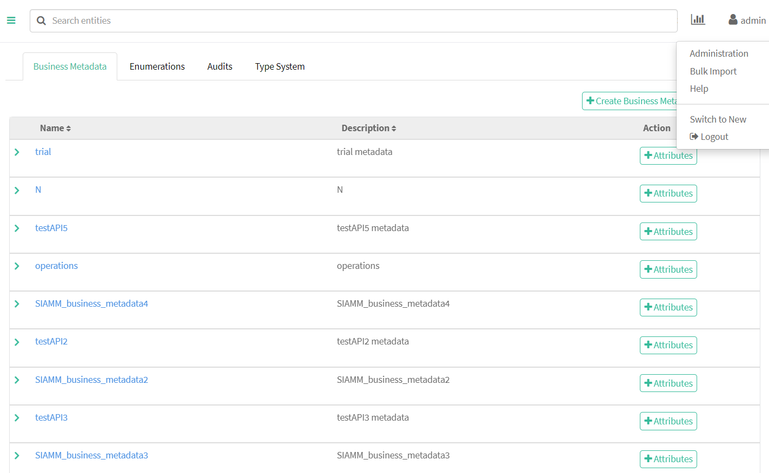
Business Data Administration
Explanation of fields in user interface
Administration
Contains information about
all business metadata with
attributes in the system.
Name – name of the business metadata
Description – the name of hte system
to which business metadata belongs
Action – the field to add attributes
Manually to business metadata

Slide 16
Thank You

